Slide 1
Lecture 25
Nick Rugai PhD

Slide 2
Files
The process of opening a file involves associating a file on disk with an object in memory.
We can manipulate the file by manipulating this object.
Read from the file
Write to the file

Slide 3
Files
When done with the file, it needs to be closed. Closing the file causes any outstanding operations and other bookkeeping for the file to be completed.
In some cases, not properly closing a file could result in data loss.

Slide 4
Files
Saving a word processing file
The original file on the disk is reopened in a mode that will allow writing (this actually erases the old contents)
File writing operations copy the version of the document in memory to the disk
The file is closed

Slide 5
Files
Saving a word processing file
The original file on the disk is reopened in a mode that will allow writing (this actually erases the old contents)
File writing operations copy the version of the document in memory to the disk
The file is closed

Slide 6
Files
Python is able to read and write on text files.
You must create a text file inside the main directory:
  C:\Program Files\Python38\
You must give the file the right permission or you will get an error!
Once the file is created and the proper permissions given, you can use the shell to access it.

Slide 7
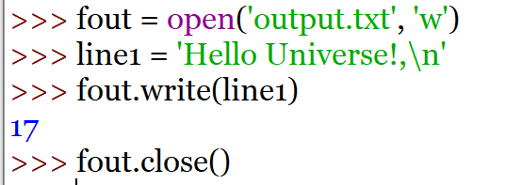
Files

Slide 8
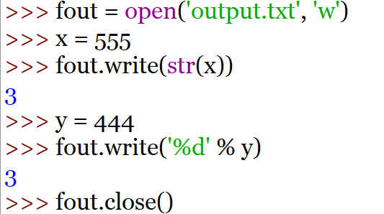
Files
The argument to be written has to be a string.

Slide 9
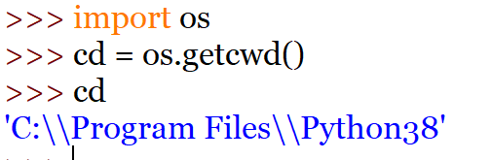
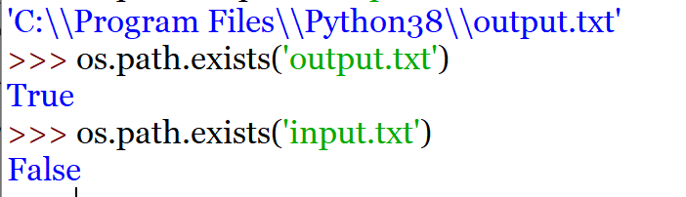
Files
Files are organized in directories AKA ‘folders’.
os allows to deal with directories.
getcwd() allows to view the current working directory.

Slide 10
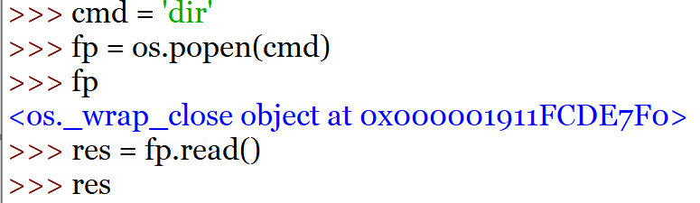
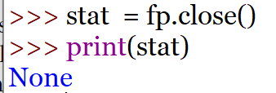
Files
A pipe object allows to execute a dos or linux command:

Slide 11
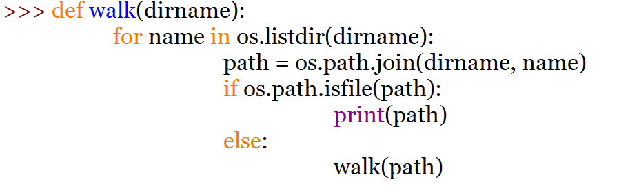
Files
Let’s write a function that display all files in a directory:

Slide 12
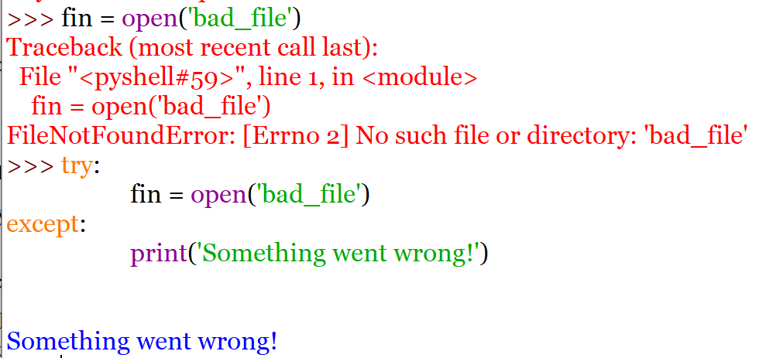
Files
Lots of things can go wring while trying to access files in a directory:

Slide 13
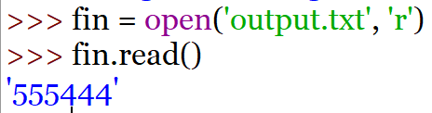
Files
The ‘r’ command allows to read a file but not write into it:

Slide 14
Files
<file>.read() – returns the entire remaining contents of the file as a single (possibly large, multi-line) string
<file>.readline() – returns the next line of the file. This is all text up to and including the next newline character
<file>.readlines() – returns a list of the remaining lines in the file. Each list item is a single line including the newline characters.

Slide 15
Files
readline can be used to read the next line from a file, including the trailing newline character
infile = open(someFile, "r")
for i in range(5):
  line = infile.readline()
print(line[:-1])
This reads the first 5 lines of a file
Slicing is used to strip out the newline characters at the ends of the lines.

Slide 16
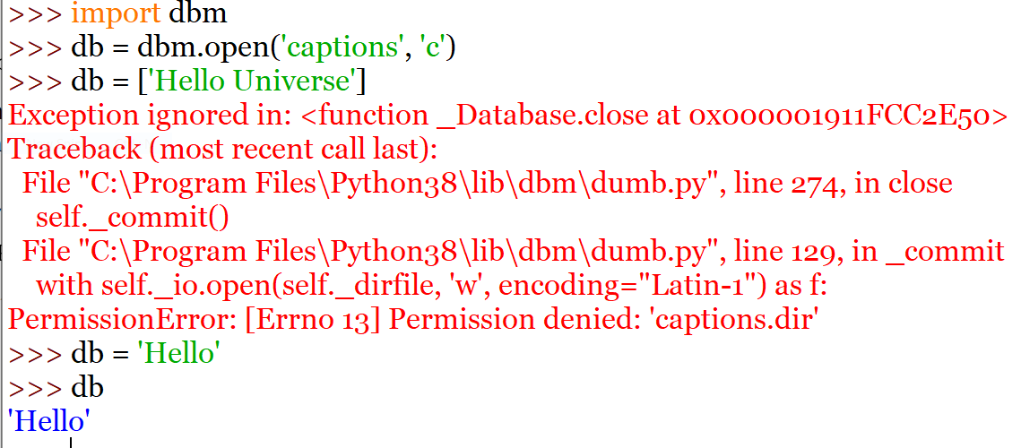
Databases
Using the text editor, create a database called captions.dat.
Give the right permission and transfer it in the current Python directory.

Slide 17
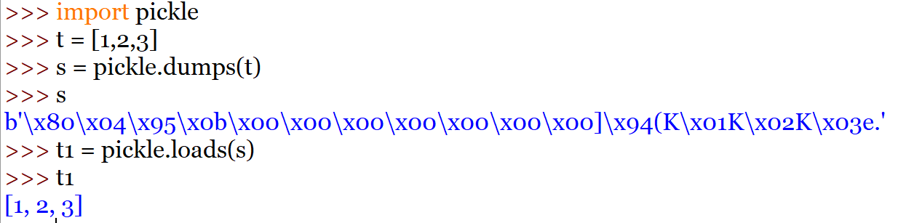
Databases
With dbm, keys and values have to be bytes of string otherwise you get an error.
The library pickle can help:

